Slide 1

Presentation
Team Heyday
Dec 20th 2023
Creative Fusion Course

Slide 2
How is the web page structured?
WEBPAGE
Consists of 3 elements
01
02
03
HTML
CSS
JavaScript
Structure of the web
Visual representation of the web
Dynamic processing of the web

Slide 3
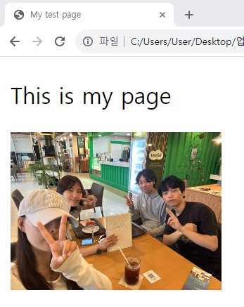
HTML - HyperText Markup Language
<!DOCTYPE html>
<html lang="en">
<html>
<head>
<meta charset="utf-8" />
<title>My test page</title>
</head>
<body>
<p>This is my page</p>
<img src="../img/materialMuseum/materialMuseum (1).jpg" width="150px">
</body>
</html>

Slide 4
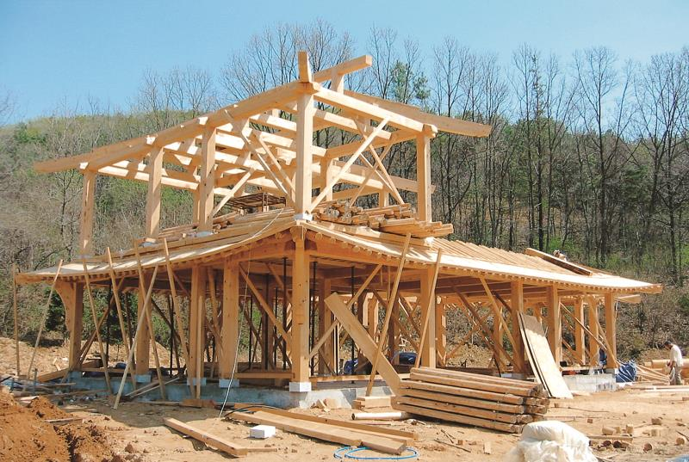
HTML

Slide 5
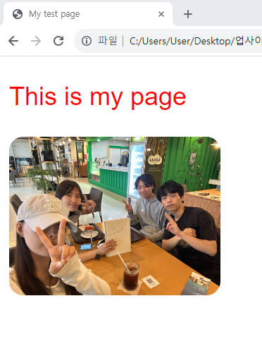
CSS - Cascading Style Sheets
body {
font-family: 'Arial’, sans-serif;
}
p {
color: red;
font-size: 18px;
}
img {
border-radius: 10px;
}
img:hover{
transform: scale(1.1);
}

Slide 6
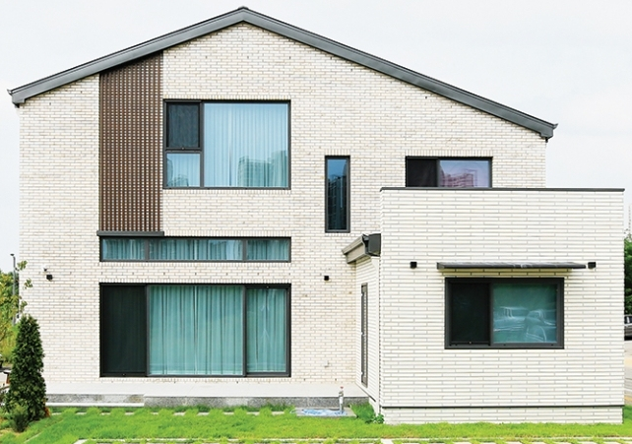
CSS

Slide 7
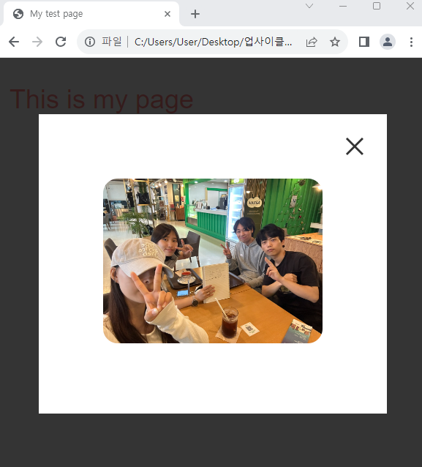

JavaScript - Adding Interactivity
Click!
Use the fancybox library

Slide 8
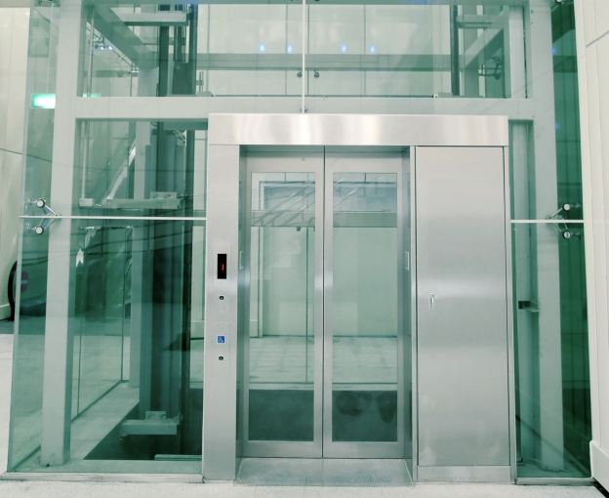
JavaScript

Slide 9
HTML
CSS
JavaScript

Slide 10
Thank You

